Slide 1
Linear Algebra
Lecture 14

Slide 2
Segment II

Slide 3
Matrix
Algebra

Slide 4
Partitioned
Matrices

Slide 5
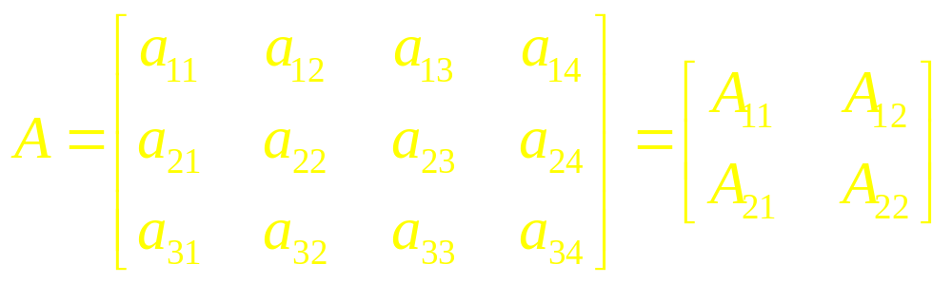
General Partitioning

Slide 6
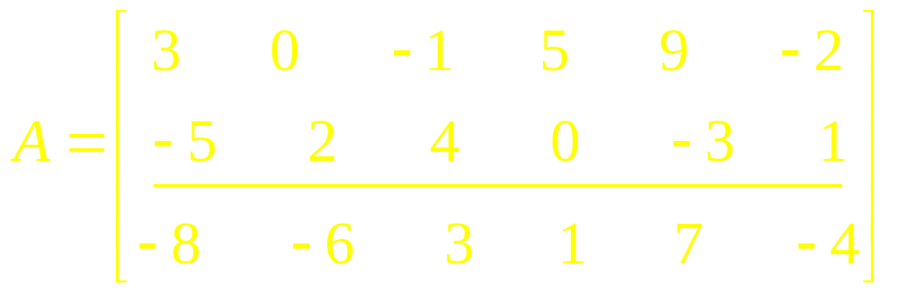
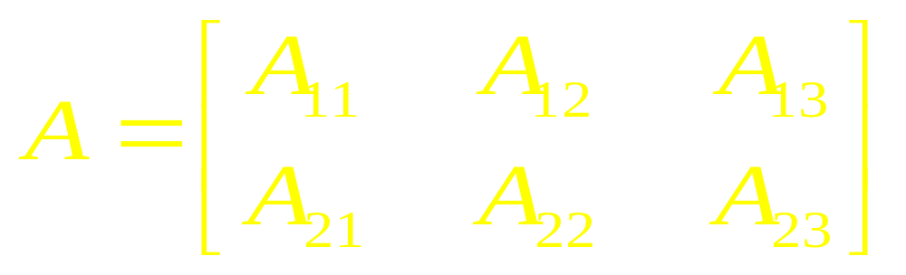
Example 1

Slide 7
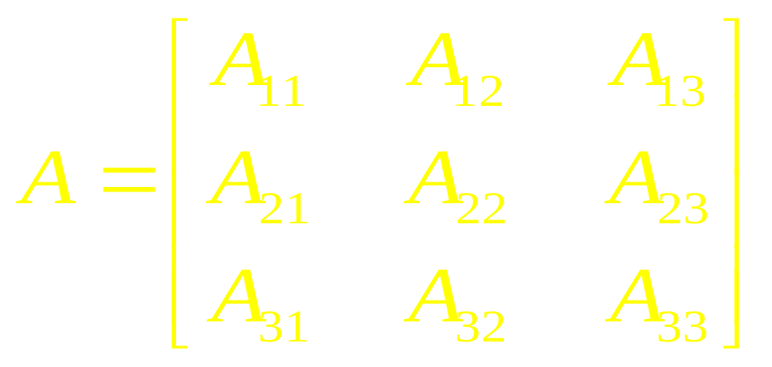
Example 2

Slide 8
Addition
and Scalar
Multiplication

Slide 9
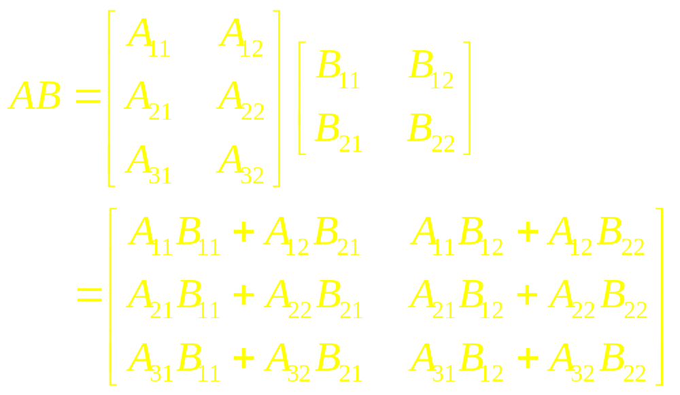
Multiplication of
Partitioned Matrices

Slide 10
Example 3
Block Multiplication

Slide 11
Example 4
Given A,
Calculate A²

Slide 12
Example 5

Slide 13
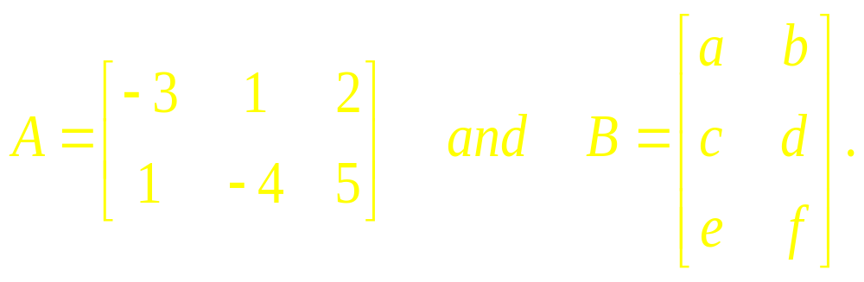
Example 6

Slide 14
Theorem
Column-Row
Expansion
of (AB)

Slide 15
Inverses of
Partitioned
Matrices

Slide 16
Example 7

Slide 17
Block Upper
Traingular
Matrices

Slide 18
Example 8

Slide 19
Example 9

Slide 20
Linear Algebra
Lecture 14

